Slide 1

Spain’s Electricity Shortfall
Data Analytics on Spain’s energy supply from renewable sources
Presentation by STORM

Slide 2
Company Overview
OUR MISSION
To drive our client’s data-centered projects to achieve their business strategies on improved service delivery and customer satisfaction.
STORM
CORE VALUES
Sustainability
Timely
Original
Resourcefulness
Mastery
Everyday AI, Extraordinary People

Slide 3





The Team Behind STORM
Teddy Waweru
McMunashe Munemo
Stella Njuki
Mayron Anyanga
Ogaga Oghenekohwo

Slide 4


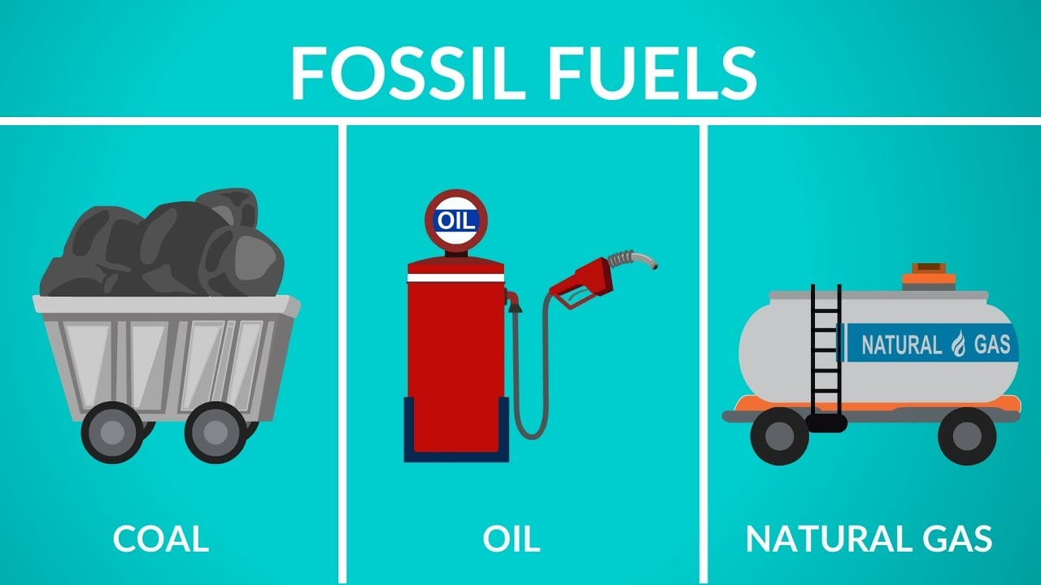
Problem Statement
Population
Industries
Fossil Fuel
Increased by 8%
since the last decade
Increased by 15% since the last decade
Heavy dependence
Notes:
In recent years, Spain has experienced an ever growing demand for electricity ,forcing the government to seek alternative options to increase production and sustain this demand.
Spain's population has grown by 8% over the last decade and industries have increased by 15% over the same period according to data from the Spain’s Bureau of Statistics. This is already putting a lot of pressure on the existing fossil fuel energy that is limited and also not sustainable.

Slide 5
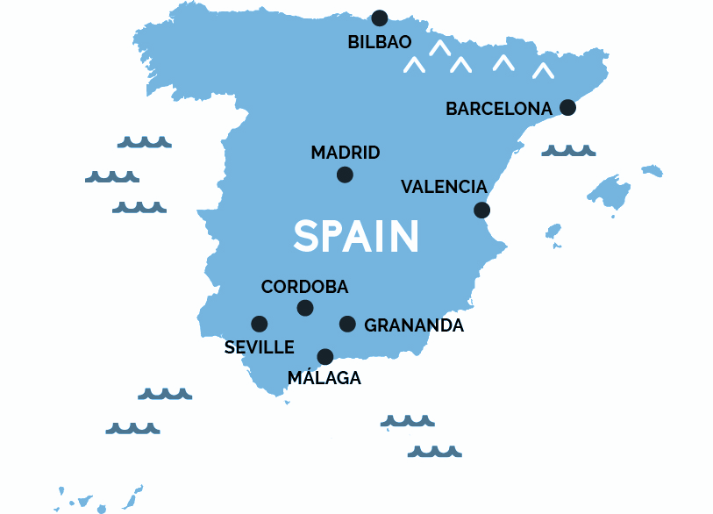
Problem Statement
The Problem
By analyzing the effect of different weather features with time on energy supplied, we can help the Spanish government predict future energy deficit from renewable resources. (Vision)
There is evidence that the use of purely non-renewable power resources is unsustainable. Transitioning into renewable resources is inevitable. (Issue)
Within the data team, we developed data solutions that model the shortfall between the energy produced by fossil fuels and various renewable energy sources to accommodate for deficits in the power grid. (Process)
Notes:
We were approached by the government of Spain to research on the trends and patterns of the country's renewable and fossil fuel energy generation with the view of providing recommendations to prevailing scarcity challenge that exists in Spain.

Slide 6
OVERVIEW
DATA ANALYSIS
DATA ENGINEERING
MODEL BUILDING
API DEPLOYMENT
Notes:
Thanks Ogaga for that wonderful introduction..This presentation covers data analysis,data engineering,model building and API deployment.

Slide 7
03
Exploratory Data Analysis
Notes:
Under EDA we looked at a number of things.

Slide 8
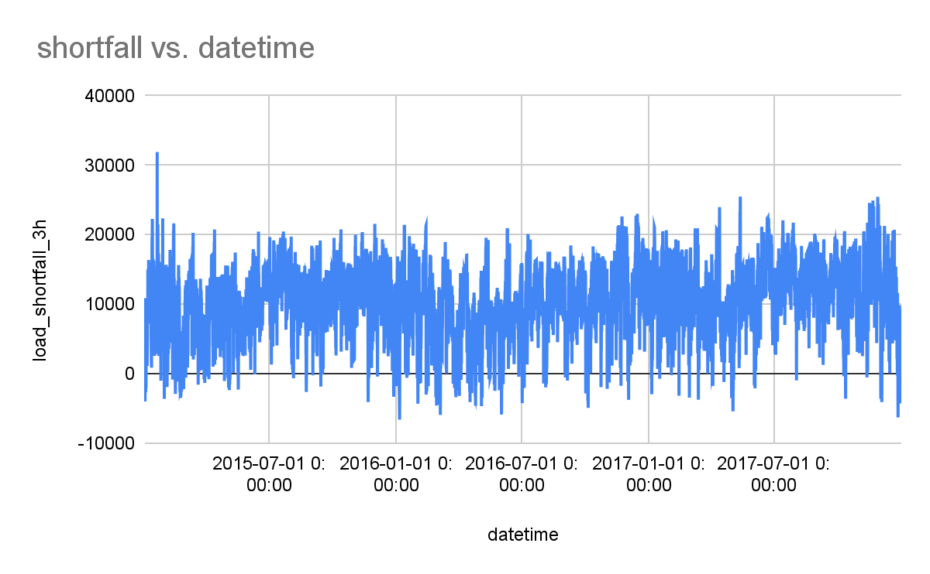
Dataset Features
EDA
Weather Attributes
Wind (speed, direction)
Temperature
(avg, min, max)
Pressure
Rainfall (1h, 3h)
Humidity
Snow
Cloud cover
Time (yr. 2015 - 17)
Time series graph
Visualizations to show distribution against predict variable
Notes:
First : We looked at the dataset, which contained 48 features on weather attributes as can be seen on this slide [with information wind, rain, humidity, cloud, pressure, snow and temperature]. The data was collected from 5 cities in Spain for the period January 2015 to December 2017

Slide 9
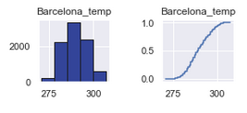
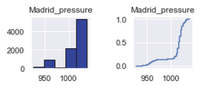

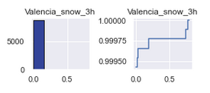
Features Analysis
Feature data types e.g numerical,categorical
Data statistics i.e. mean, median, SD etc
Looked at feature distributions
Notes:
Second: We analysed the data shape and types i.e. float or object, numerical or categorical as this determined the visualizations to be used in our presentation
We also calculated the data statistics like mean, median, SD and looked at feature distributions to check for data symmetry

Slide 10
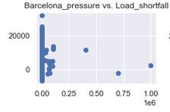
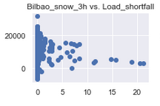
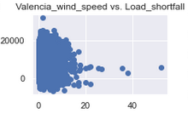
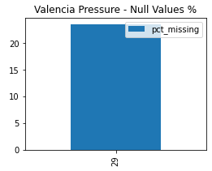
Features Analysis
Check for null or missing values,outliers
Notes:
Third : We checked for missing values and duplicate columns to ensure that we get accurate insights in data engineering.
Our dataset contained 23% null values under valencia pressure column and 1 duplicate column

Slide 11
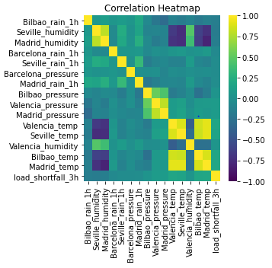
Features Analysis
Plot relevant feature interactions
Evaluated correlation
Notes:
Last:We checked for weather features correlation, both + and - as it determines how 2 weather attributes change together.We were looking for strong +ve or -ve correlation highlighted in yellow and only picking one correlated feature to be used in our tabulation for the load shortfall prediction.
My colleague Munashe will go ahead to explain how data engineering was done.

Slide 12
04
Feature Engineering

Slide 13

Feature Engineering, Selection
Feature Engineering
Changes made to the dataset
Removed missing values/ features and duplicate column(unnamed 0)
Created new features using one-hot encoding technique to get dummy variables
Engineered existing features to remove outliers
Notes:
As previously seen, Valencia_pressure contained 2068 null values. In order to carry out the replacement, we need to determine the columns that show the highest correlation with Valencia_pressure.
Based on the correlation heatmap above, we can see the highest correlation would be with the pressure attributes of other cities with the highest correlation being with Madrid_pressure. This can be concluded as to being due to the close proximity of the cities & that they're all at fairly the same height above sea level.
We shall use Madrid_pressure to fill in the missing values.

Slide 14
05
Modelling

Slide 15
Understanding Machine Learning
Machine Learning is the process of identifying pattern in the data.
You can think of a pattern as the “way that things work”
Machine Learning does this by understanding the relationship between the features (X) and the target (y).
Notes:
We are going to test the effectiveness of 3 models that vary in complexity.
Ordinary Linear Square Regression
Decision Tree
Random Forest

Slide 16
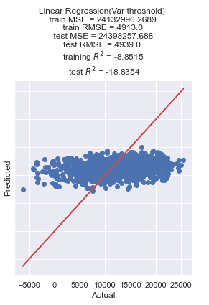
Model used
OLS
Ordinary least squares (OLS) regression estimates the relationship between one or more independent variables and a dependent variable
Notes:
Ordinary least squares (OLS) regression is a statistical method of analysis that estimates the relationship between one or more independent variables and a dependent variable; the method estimates the relationship by minimizing the sum of the squares in the difference between the observed and predicted values of the dependent variable configured as a straight line. In this entry, OLS regression will be discussed in the context of a bivariate model, that is, a model in which there is only one independent variable ( X ) predicting a dependent variable ( Y ). However, the logic of OLS regression is easily extended to the multivariate model in which there are two or more independent variables.

Slide 17
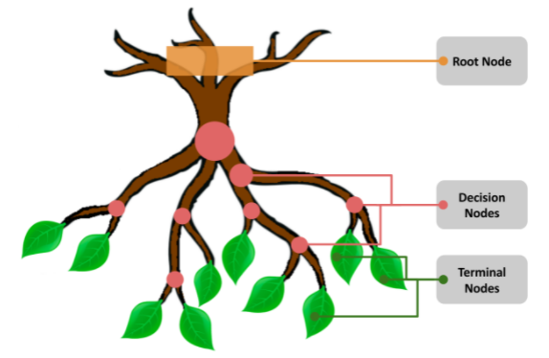
Model used
Decision Tree
Build a model by splitting the data into subsets based of the target variable.
Notes:
Ordinary least squares (OLS) regression is a statistical method of analysis that estimates the relationship between one or more independent variables and a dependent variable; the method estimates the relationship by minimizing the sum of the squares in the difference between the observed and predicted values of the dependent variable configured as a straight line. In this entry, OLS regression will be discussed in the context of a bivariate model, that is, a model in which there is only one independent variable ( X ) predicting a dependent variable ( Y ). However, the logic of OLS regression is easily extended to the multivariate model in which there are two or more independent variables.

Slide 18

Model used
Random Forest
It’s an Ensemble of Decision Trees
Notes:
Ordinary least squares (OLS) regression is a statistical method of analysis that estimates the relationship between one or more independent variables and a dependent variable; the method estimates the relationship by minimizing the sum of the squares in the difference between the observed and predicted values of the dependent variable configured as a straight line. In this entry, OLS regression will be discussed in the context of a bivariate model, that is, a model in which there is only one independent variable ( X ) predicting a dependent variable ( Y ). However, the logic of OLS regression is easily extended to the multivariate model in which there are two or more independent variables.

Slide 19
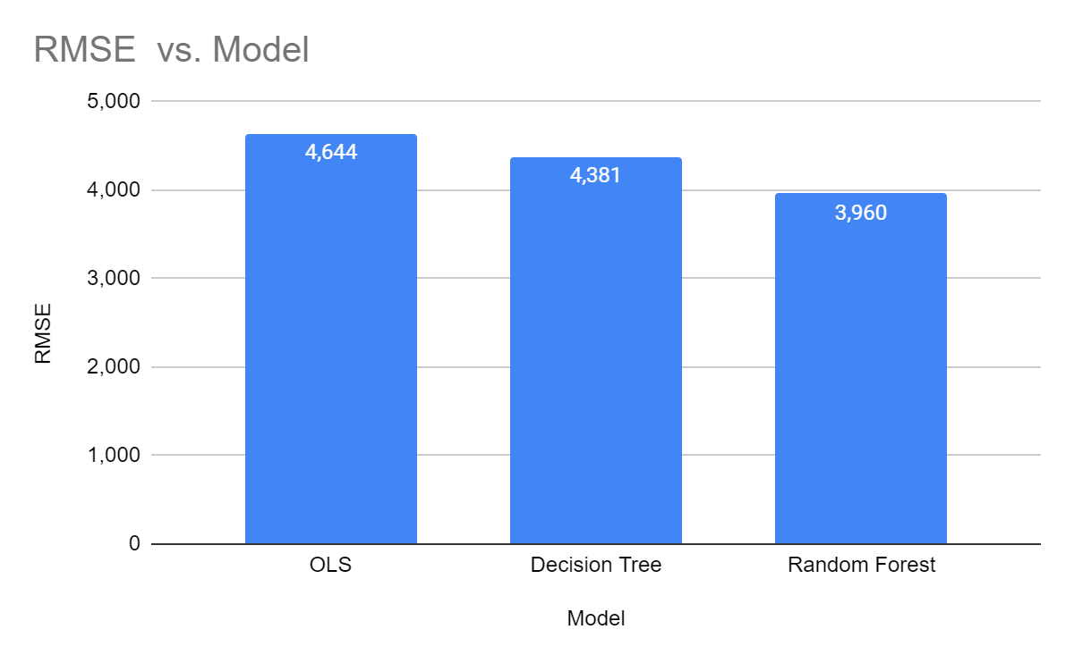
Models used
Notes:
We will evaluate our models using a metric for regression machine learning: the mean squared error (MSE). but MSE is highly biased for higher values. RMSE is better in terms of reflecting performance when dealing with large error values. Which we have in this case. As you can clearly see the Random Forest has the lowest score of all the models we used. And that why we picked it. Moving on Stella will elaborate more on the Random Forest Model

Slide 20
06
API DEPLOYMENT

Slide 21
HOW THE API WORKS
Random Forest Model
Computer
Request
API
Response

Slide 22
Future Considerations/Developments
Include North Western Region
Analysis to include distribution of generating plants.
API Development. Applying multiple data points in our predictions, & real time application.

Slide 23
Executive Summary
The Objective
To analyse Spain’s electricity shortfall due to reduced supply by renewable sources by analysing weather attributes in specific Spanish cities.
The Process
We utilized data analysis & machine learning principles to predict future shortfall circumstances.
The Outcome
We developed a scalable data processing pipeline from the data, & a predictive model that can be implemented in determining shortfall.
The system can offer to strategic energy planning in the renewable sector.

Slide 24
Objective
Analysis of Spain’s load shortfall & relating it to the weather attributes of specific cities across the country
Observations
Key features that contribute to the load shortfall: temperature, rainfall, wind &
Actionable Strategies
Implementation of strategic renewable energy projects dependent on locations.
Maximize on weather attributes with high consistency.

Slide 25

—Andrejs Dunkels
“It’s easy to lie with statistics It’s hard to tell the truth without statistics.”

Slide 26
Thanks!
Do you have any questions?
Please keep this slide for attribution

Slide 27
END

Slide 28
Model Explanation
Notes:
Shortfall values do not have a specific pattern
Shortfall values neither increase with time nor decrease
A random forest model is perfect for predicting such values

Slide 29
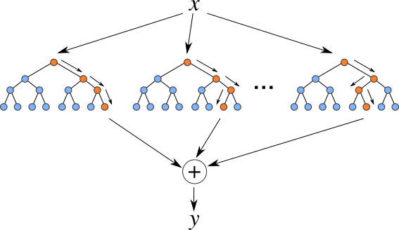
Combined 300 decision trees
Each tree had 25 splits

Slide 30
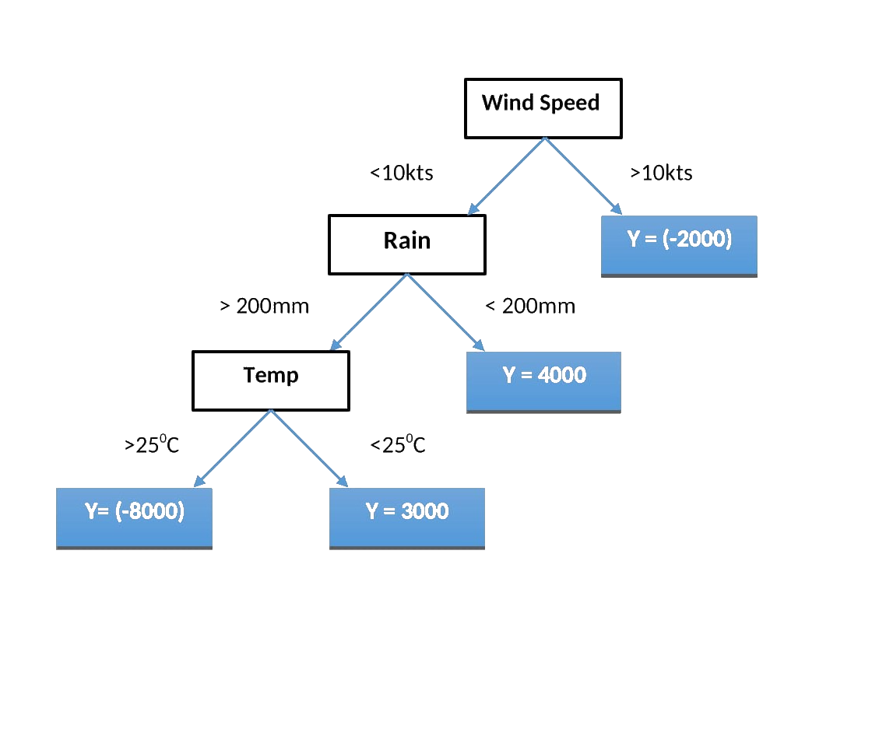
RANDOM FOREST MODEL
Notes:
ML model employed.
Brief overview of the working principle, & how it aligns with our current problem statement

Slide 31
Based on the predictive nature of the problem what can we conclude about it?
How would the typical response/solutions be structured/ aligned with ongoing operations?
Actionable points

Slide 32
Company Overview
PROFILE
We assist organizations by meeting their business strategy definitions , planning and to help them realise their overall objectives of improved service delivery and customer satisfaction.
CORE VALUES
Sustainability
Timely
Original
Resourcefulness
Mastery

Slide 33
Alternative Resources
Find more illustrations like these on Stories by Freepik

